Slide 1
Advances in the Automation of Method Development and Prep Purification in Counter Current Chromatography (CCC)
Gary Yanik (PDR-Separations)
Leo Hsu, Xiqin Yang, Dave Thornton (GSK)

Slide 2
Presentation Outline
Introduction
Features
Hardware
Systems
Workflow
Software
Conclusions
Acknowledgements

Slide 3
Introduction
Objective: Develop a generic automation system for CCC method development and prep that is compatible with short-run, fast-pace, low-labor, unattended operation
Traditional method development approaches, such as shake-flask, are labor intensive
AutoCCC uses methods/sequences like HPLC to automate method development and prep for unattended operation
Eluent Mixer is key to automated solvent screening
AutoCCC installed on CCCs from 2 different manufactures (UK and China) with good success

Slide 4
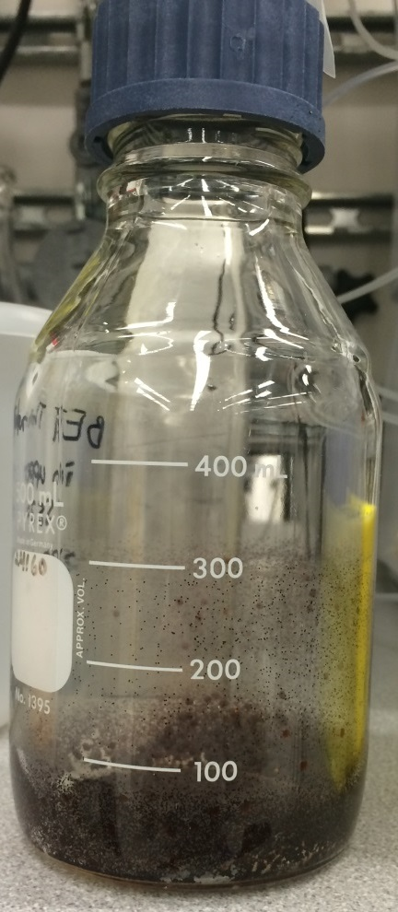
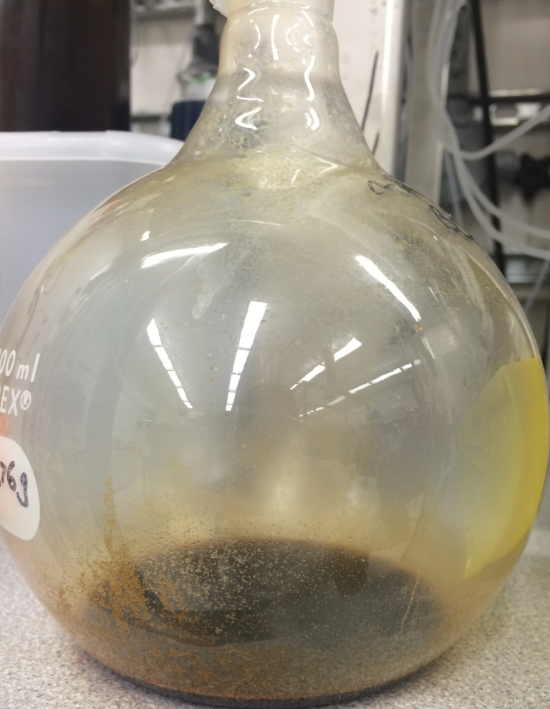
CCC can handle Dirty Jobs
(no packing, easy to clean)
Feed
Dried Product

Slide 5
Features
● Automated control of CCCs, pumps, detectors, chillers
● On-demand isocratic/gradient mixing of 10 or 20 solvents
● Syringe-pump injector with 9 programmable ports
Fill loop from multiple ports
Sandwich sample in upper and sample in lower phases to minimize equilibrium upset (A + B + A) or (B + A + B)
● Large loops filled with multiple syringe strokes
● Injector and Collector integrated with into one module
● Selection valves for normal/reverse, analytical/prep switching
● Useful addition to purification tool box
- Same method development and prep approach for all techniques HPLC, SFC, CCC, etc.

Slide 6
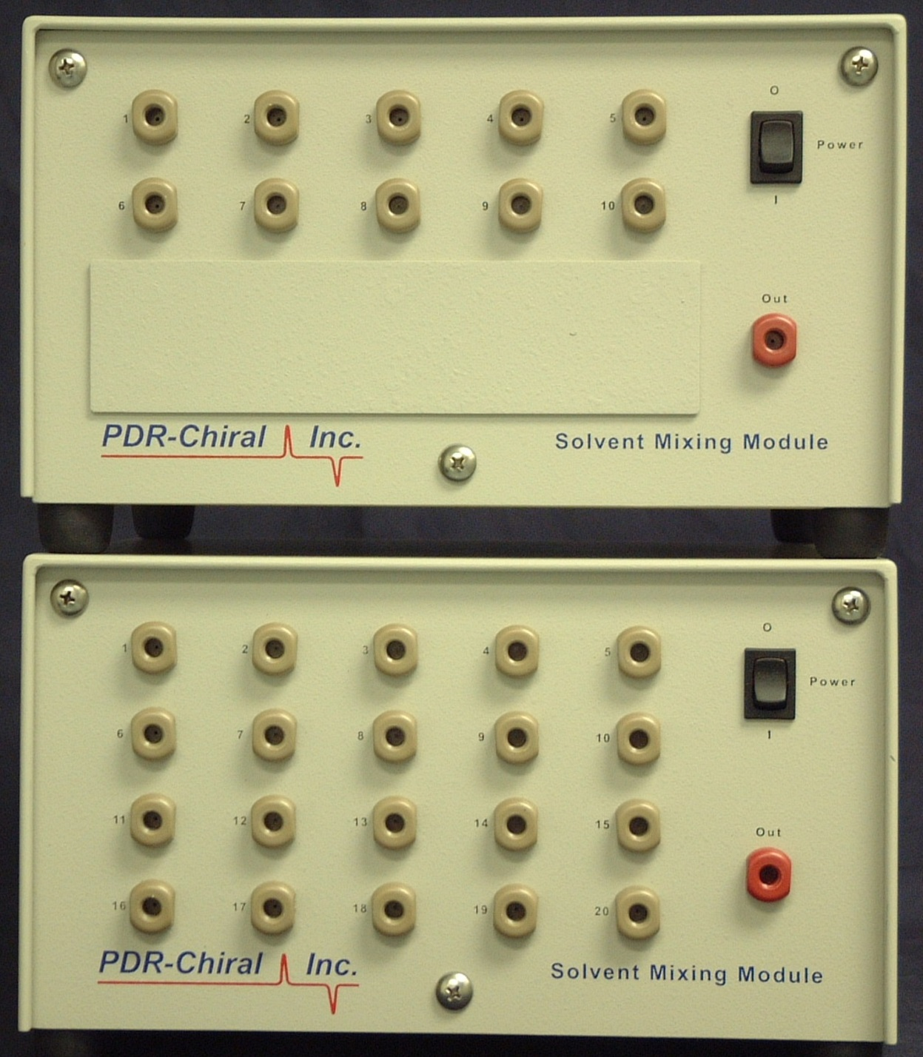
Low Pressure Gradient Mixer
● 10 or 20 Bottles
● On-Demand Mixing, isocratic /gradient
● uP inside for accurate control

Slide 7
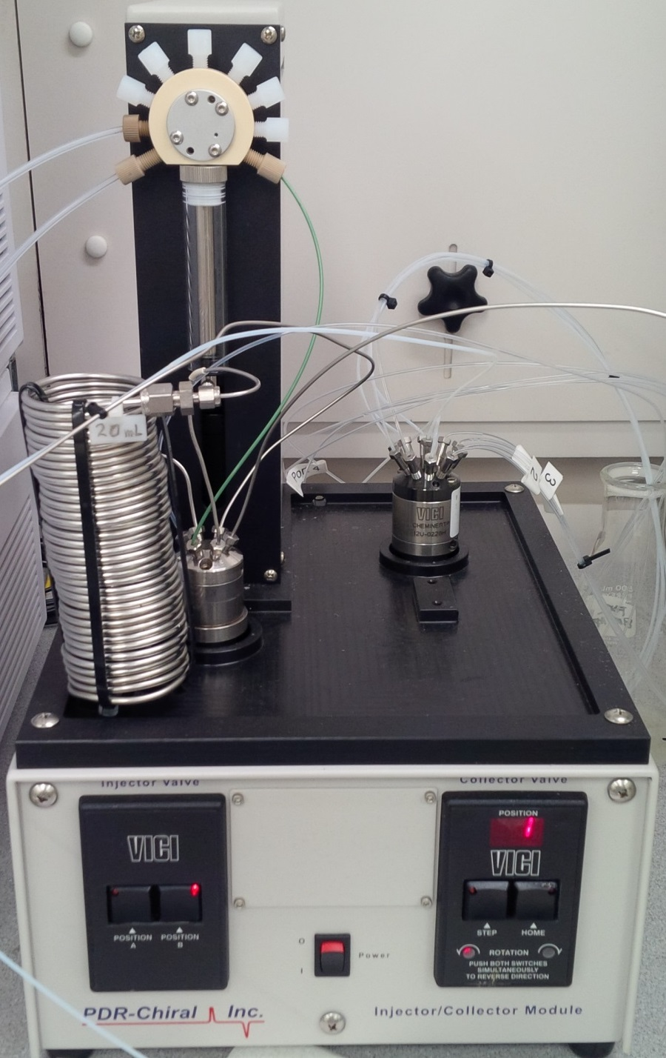
Intelligent Injector/Collector
● Balance and sandwich injections from sample dissolved in stationary and mobile phase
● Extra syringe ports for washing or creative injection schemes
● Collect up to 9 peaks

Slide 8
DE Spectrum Comparison
Before | Now
Solvent mixer 4-channel Limited solvent combinations without operator intervention | Solvent mixer 20-channel Many more solvent combinations available with automation
Injector Slow and an additional feed pump is needed for injection >100 uL | Injector Faster: looks ahead; smarter: balances mobile/stationary phases; volume limited only by loop size: can multiple stroke
Switching valves Manual valves switch between modes: analytical/prep, reverse/normal phase; requires operator to be there | Switching valves Automated valves switch between various modes, embedded in method
Software Rigid (Agilent ChemStation) – no control of CCC rotor or chiller – no overnight operation | Software Flexible (PDR AutoCCC) – controls rotor, chiller, etc. allowing overnight operation; can collect on UV, pH, polarimeter, etc.

Slide 9
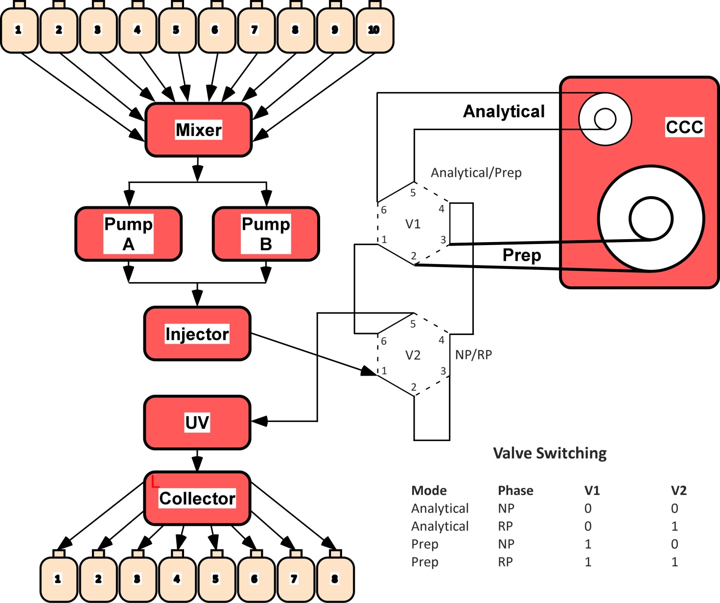
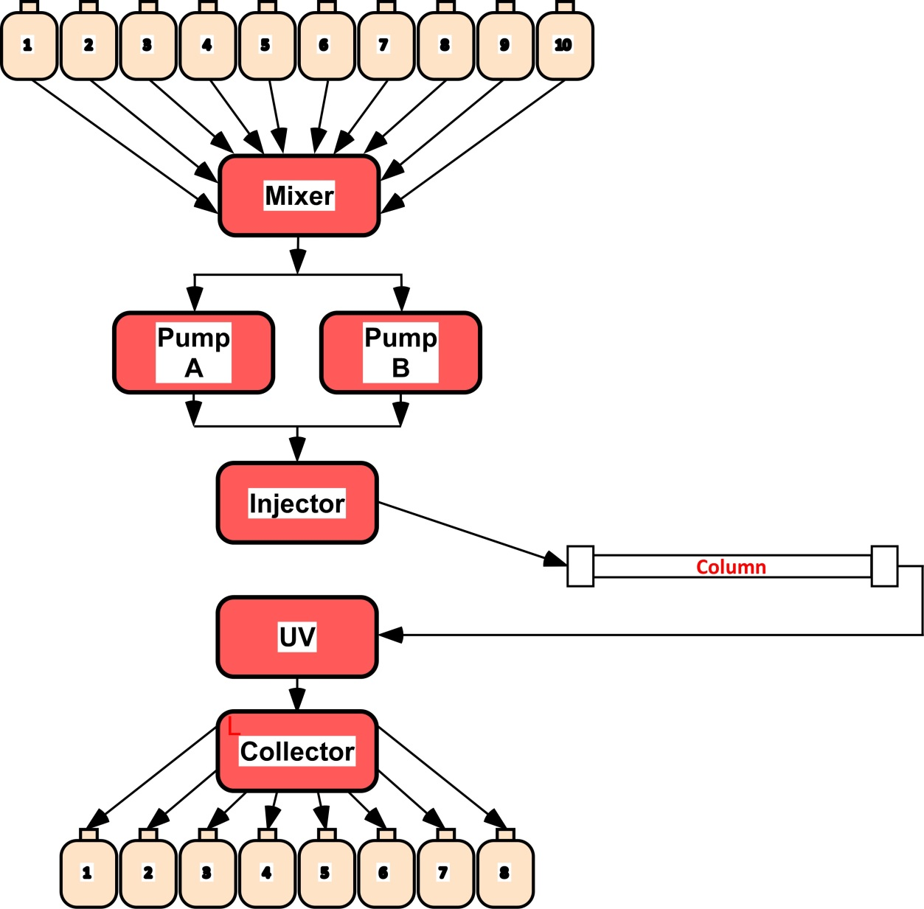
MDS & Prep, DE Spectrum Plumbing

Slide 10
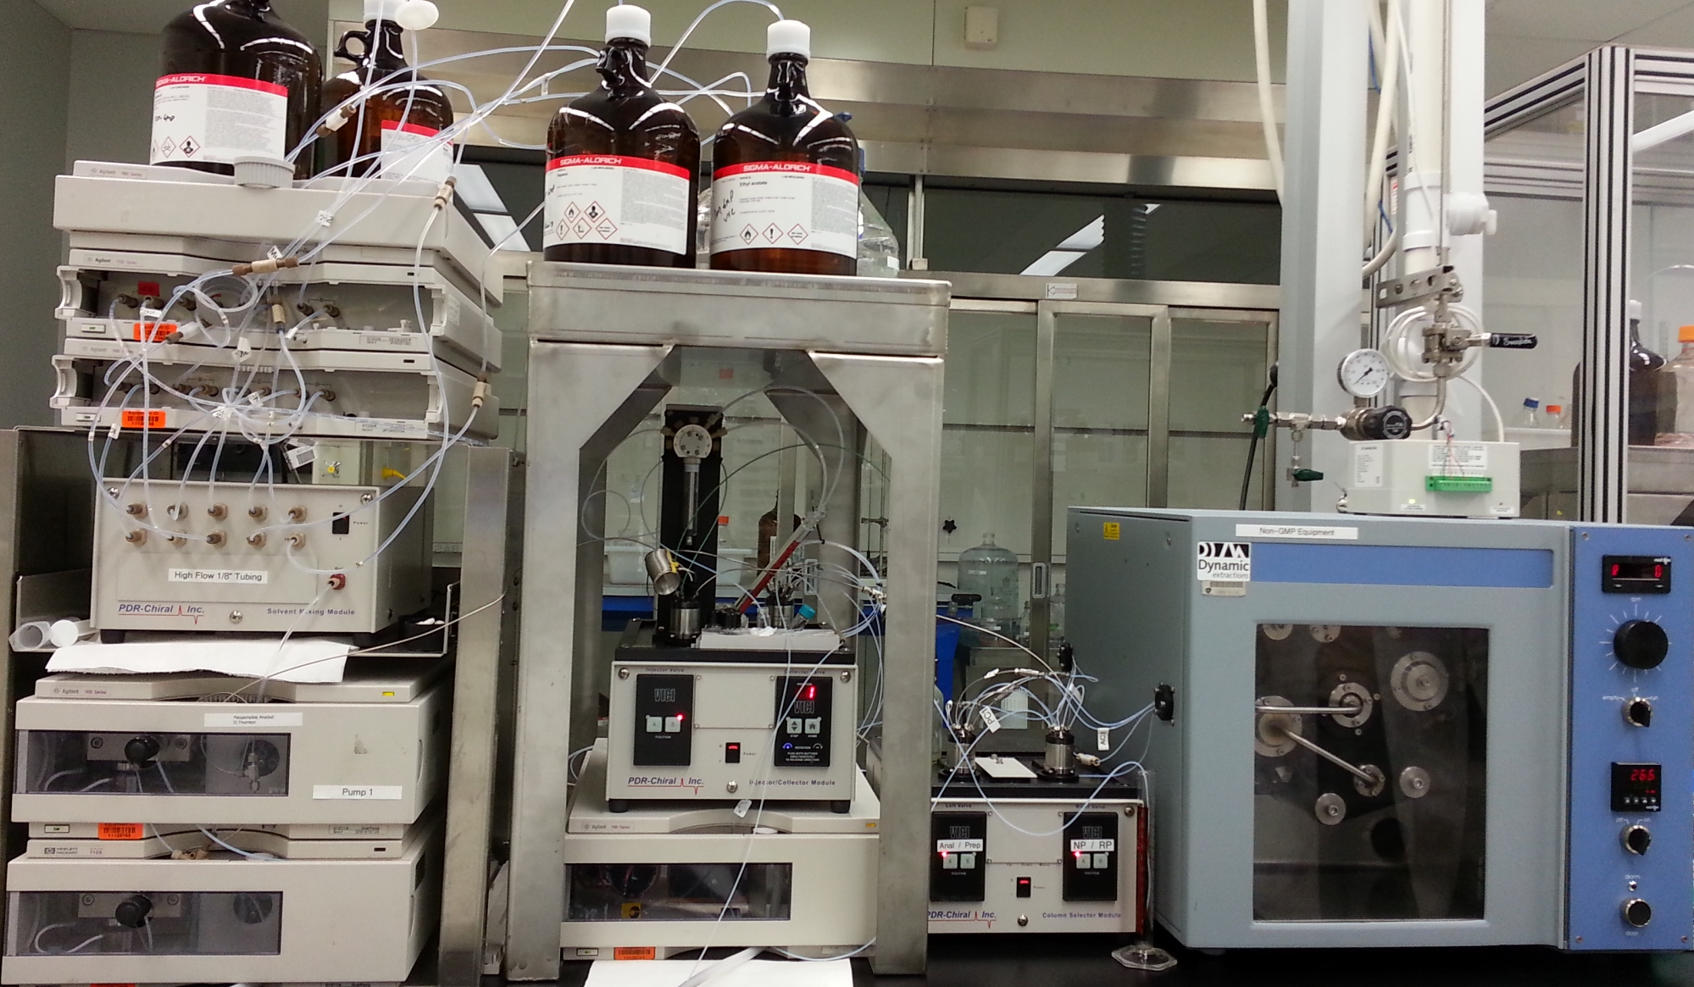
AutoCCC on DE Spectrum - MDS & Prep 24/267 mL
Degassers
Eluent Mixer
Injector
Collector
CCC
Dual Pumps
DAD
Valve Box
NP/RP, Ana/Prep

Slide 11
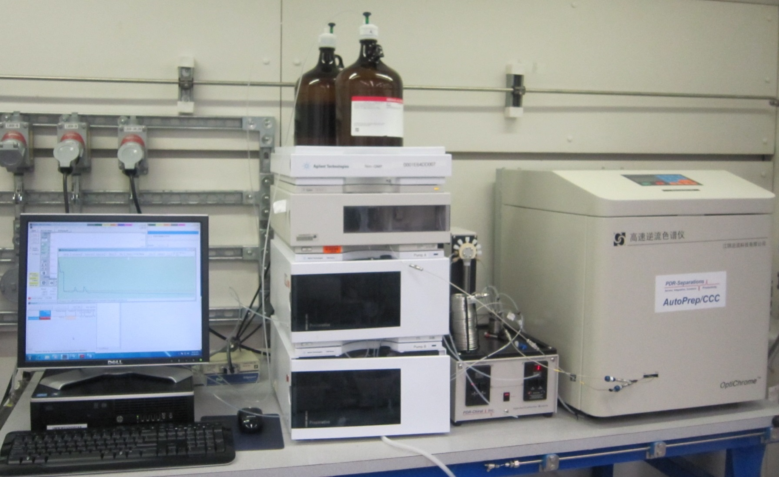
AutoCCC on JCT OptiChrome – Prep 1033 mL

Slide 12
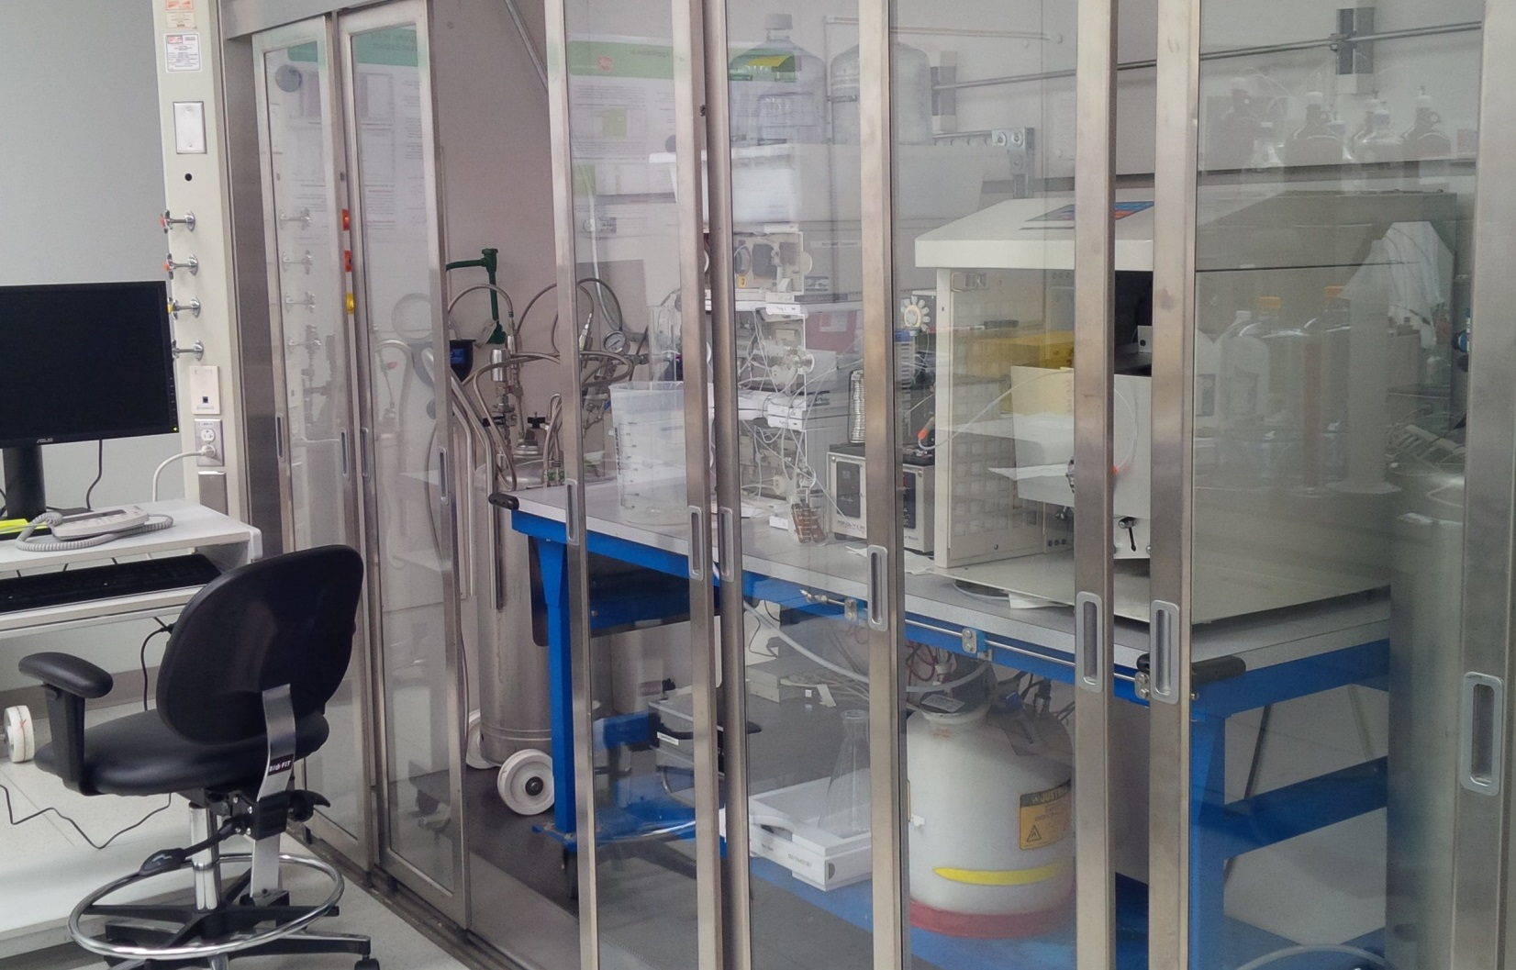
AutoCCC on JCT OptiChrome – Prep Hooded with Pressure Vessels

Slide 13
Workflow
● Prepare sample separately in Mobil and Stationary phases and connect to injector ports
● Run sample in Screening Sequence automatically
● After Sequence, thumbnail results presented in Data Screening Tool can be filtered based on multiple chromatographic parameters (number of peaks, ratio of peak areas, RT etc.)
● Select best method from screening results and optimize using single keyboard control of all parameters
● Move to Prep mode (eg Spectrum) or Prep system, same user interface regardless of hardware vendor
● Optimize at prep scale, setup/verify collection settings
● Collect automatically

Slide 14
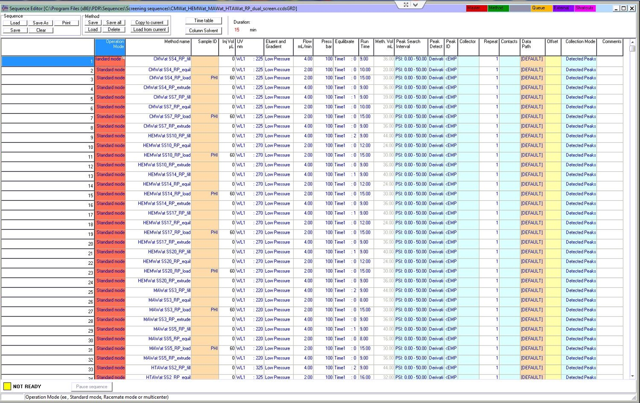
Sequence Editor

Slide 15
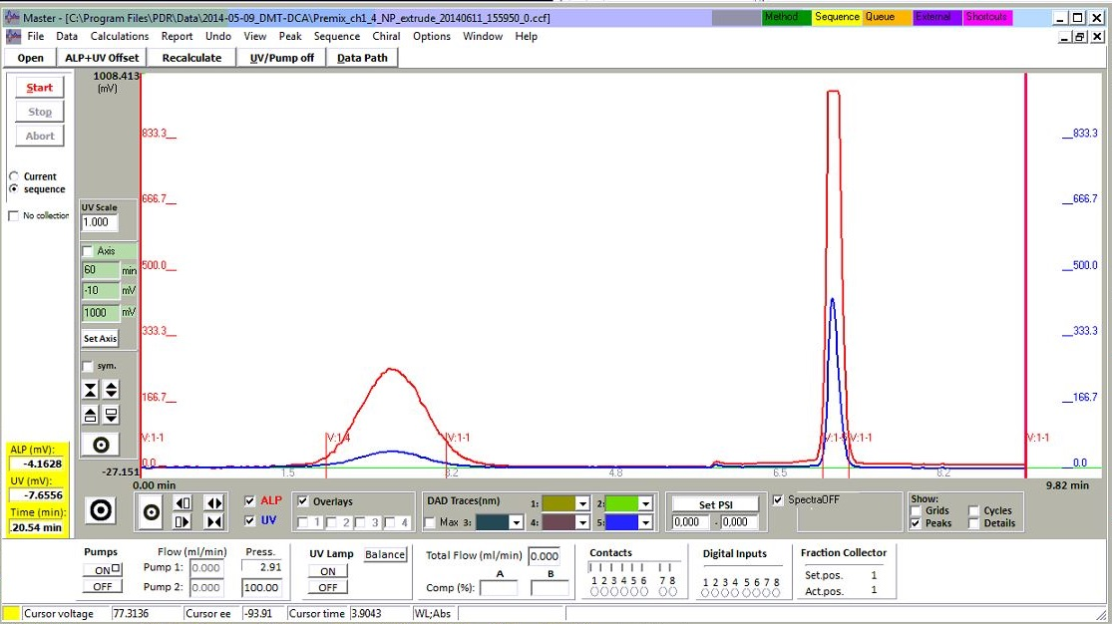
Master Window

Slide 16
Conclusions
● AutoCCC enables automated, short-run, fast-pace, low-labor method development and purifications
● Method Development and Prep Purification is now routine and systems run overnight and unattended
● AutoCCC is generic and can be applied to any CCC/CPC system
● AutoCCC operation is now similar to packed-column techniques and can be used by non-experts
● We are beginning to scout for new solvent families to extend applicability of CCC to more compounds
● Next presentation by David Thornton will discuss use of these CCC systems and results

Slide 17
Acknowledgements
Co-Authors at GSK:
Leo Hsu
Dave Thornton
Xiqin Yang
Organizations:
Brunel University
JiangYin CounterCurrent Technology (JCT)
Tauto
Dynamic Extractions (DE)

Slide 18
Thank You

